Slide 1
DFS 40203 ETHICAL HACKING
PROBLEM BASED TASK 1 PRESENTATION
NAME : GABRIEL BOY A/L DASARATHEN [ 32DDT20F2008 ]
TAMARAISELVI A/P SUBRAMANIAM [32DDT20F2024 ]
MUHAMMAD AFIQ MUHAIMIN BIN MOHD ZAINI [32DDT20F2029 ]
TAUFIQ ADHA BIN ZULNAFRI [ 32DDT20F2035 ]
CLASS : DDT4A/4B
LECTURER NAME : SHARIZAN BINTI ABDUL JAMIL

Slide 2
Question :
As a junior Python programmer from IT Tech Sdn Bhd has been assign to construct a simple system to store customer car wash record at Clean Car Wash. IT Tech Sdn Bhd is a leading IT company located in Pulau Pinang. The prospect of the company is designing web application, android system management and ICT consultant and training. The Clean Car Wash company is one of the IT Tech Sdn Bhd client.
After discussion with the client, the requirements that you required to fulfill as descriptions below.
• The basic requirements given by Clean Car Wash company for the system to be developed as follows:
• The system should be able to insert new car record and owner information. If the record successfully inserts, prompt a message to show the status of record either successful or failed. Then, go back to main menu.
• Display all the records of car register in the system.
• Update car wash information by choosing the car wash service either inner wash, outer wash or both. Update
car wash information based on car plate number.

Slide 3
Table 1: Car Wash Information
Type of Car | Wash (RM) | Vacuum (RM) | Wash and Vacuum (Rm)
Sedan | 8 | 4 | 12
MPV | 12 | 5 | 17
SUV | 13 | 5 | 18
• Delete car wash record when needed by the system.
• The system should be able to repeat the previous requirement until when the owner of the system demands so.
• The system should be able to count the total income from the system.
Using your knowledge on Python Programming, develop the system based on the basic requirements stated above. Your system application should use function, database, modules or package and also need to use at least one Exception Handling.

Slide 4
The main menu of the system should accept input from user on which the user key in the choice they would like to do based on the Figure 1. Complete the Clean Car Wash system by referring the features stated earlier. At least four (4) rows of data insert into the database.

Slide 5
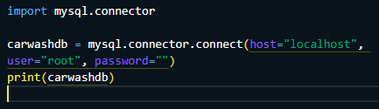
Connection to MySQL

Slide 6
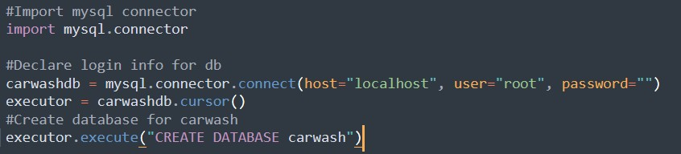
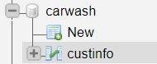
1. Create the Database

Slide 7
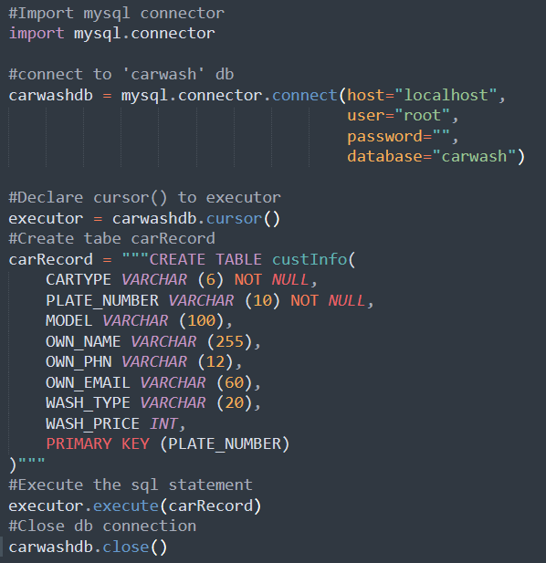
2.Create the table

Slide 8
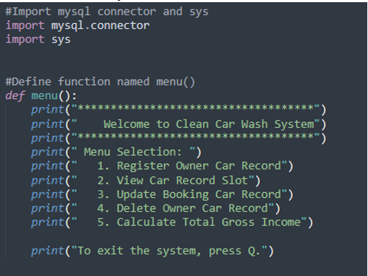
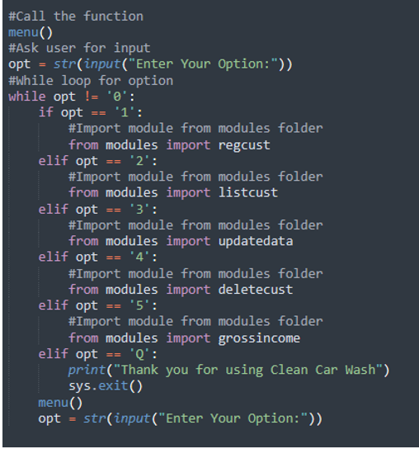
3. Main body

Slide 9
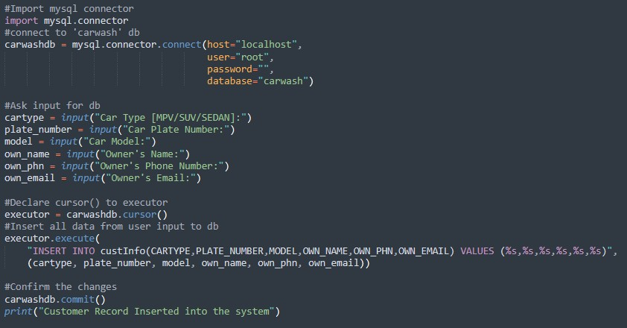
4. Option 1 Insert data.

Slide 10
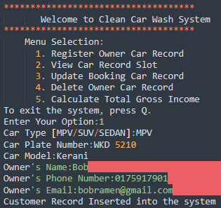
Output Option 1

Slide 11
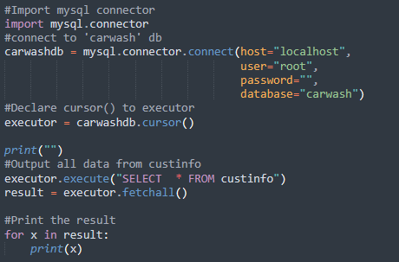
5. Option 2 view car record

Slide 12
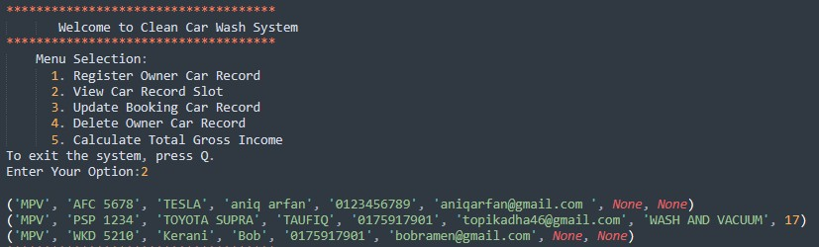
Output Option 2

Slide 13
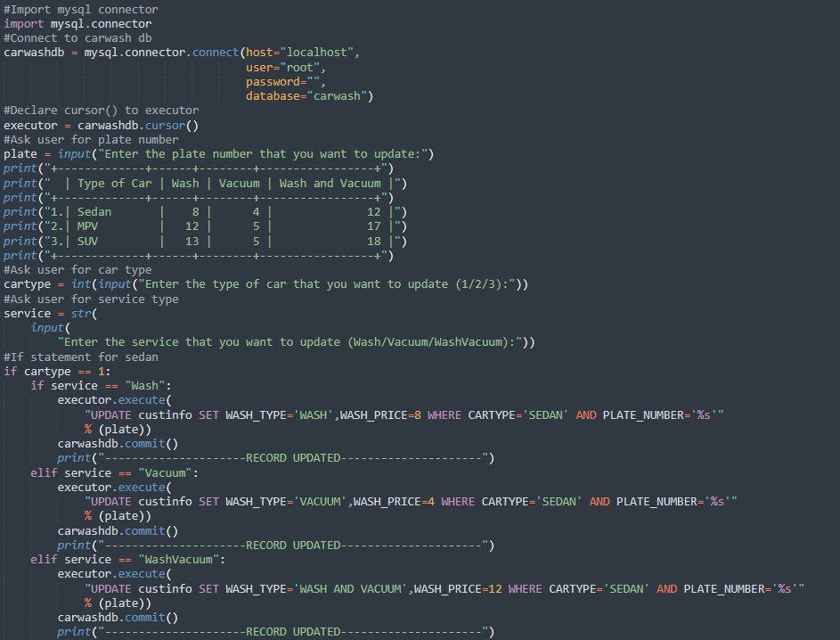

6. Option 3 Update data.

Slide 14
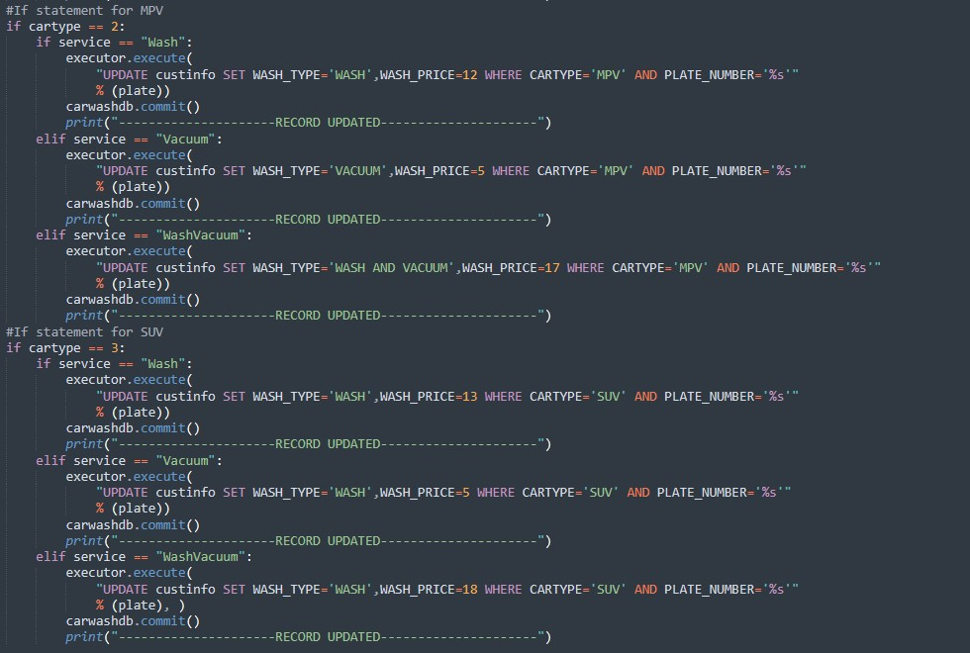


Slide 15
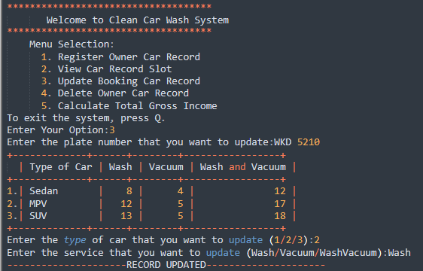
Output Option 3

Slide 16
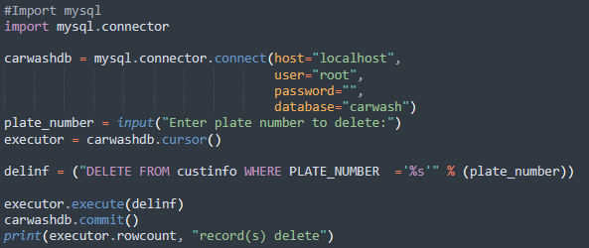
7. Option 4 Delete car record

Slide 17
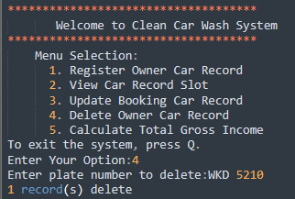
Output Option 4

Slide 18
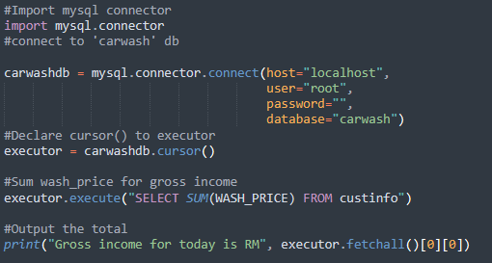
8. Option 5 gross income

Slide 19
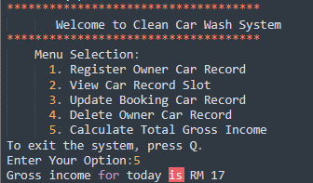
Output Option 5

Slide 20
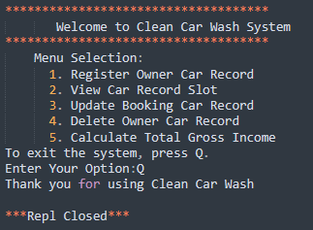
Output exit system

Slide 21
Thanks!

